Slide 1
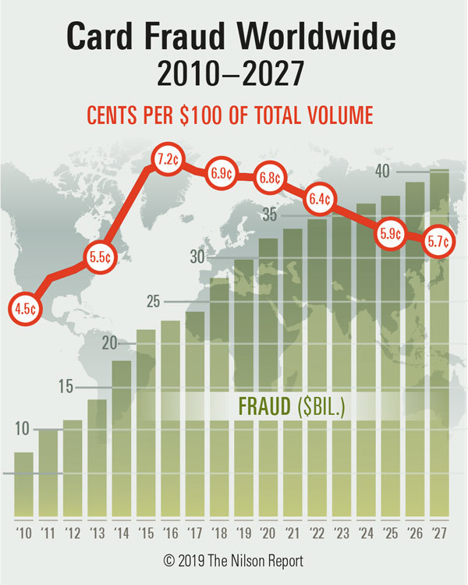
Credit Card Fraud Detection Using ML on AWS
Cloud Computing | Spring 2022
Dr. Walcelio Melo
Group 1:
Mina Hanna | Ali Can Mutlu | Mojahid Osman
Notes:
Intro – Ali

Slide 2

Agenda
Introduction, dataset and project approach
AWS architecture
Setting up QuickSight
EDA
Machine Learning and modeling
Final representation
Conclusion

Slide 3

Introduction
According to the FBI, credit card fraud is the unauthorized use of a credit or debit card, or similar payment tool (ACH, EFT, recurring charge, etc.), to fraudulently obtain money or property. Credit and debit card numbers can be stolen from unsecured websites or can be obtained in an identity theft scheme.
It is important that credit card companies are able to recognize fraudulent credit card transactions so that customers are not charged for items that they did not purchase.

Slide 4
Dataset description:
The datasets we are using for this project contains transactions made by credit cards in September 2013 by European cardholders. We have 492 frauds out of 284,807 transactions
The dataset is highly unbalanced, the positive class (frauds) account for 0.172% of all transactions.
The dataset contains only numeric input variables which are the result of a PCA transformation.
Due to confidentiality most of features has been transformed V1, V2, … V28, except 'Time' and 'Amount'.

Slide 5
Project approach
Picking Credit Card Dataset
Computational Approach
ML not the Goal Exploring AWS is

Slide 6



Core project tracks
Follow a traditional pipeline with EDA and ML modeling
Utilize AWS components
(QuickSight, Django, Sagemaker.. Etc.)
Spot our findings and observations

Slide 7
Agenda
Introduction, dataset and project approach
AWS architecture
Setting up QuickSight
EDA
Machine Learning and modeling
Final representation
Conclusion

Slide 8









AWS tools overview
QuickSight
SageMaker
S3
IAM policies
Keras Boto Usage
VPCs
AutoML
Notes:
- Mojahid Takes over

Slide 9




Project Architecture – High Level
AWS
Internet getaway
Public subnet
Private subnet
Security group
Security group
+

Slide 10
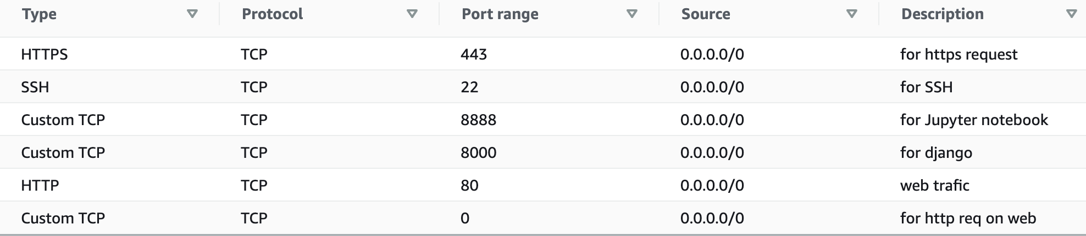
Project Architecture – Security Protocols
Security group – Client's access – Inbound rules

Slide 11
Agenda
Introduction, dataset and project approach
AWS architecture
Setting up QuickSight
EDA
Machine Learning and modeling
Final representation
Conclusion

Slide 12
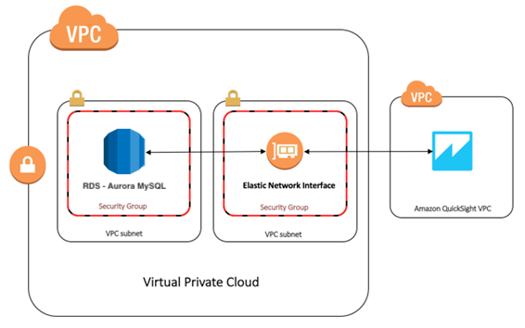
Project Architecture – QuickSight

Slide 13
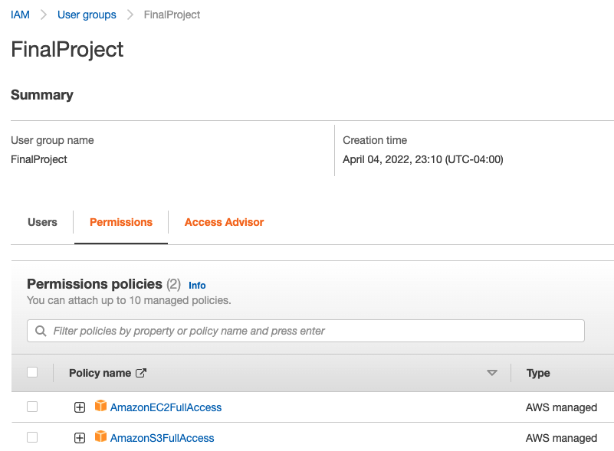
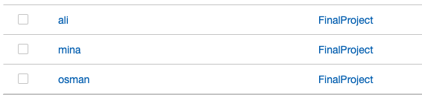
QuickSight | IAM Configuration
Create users for the project and maintain the access

Slide 14
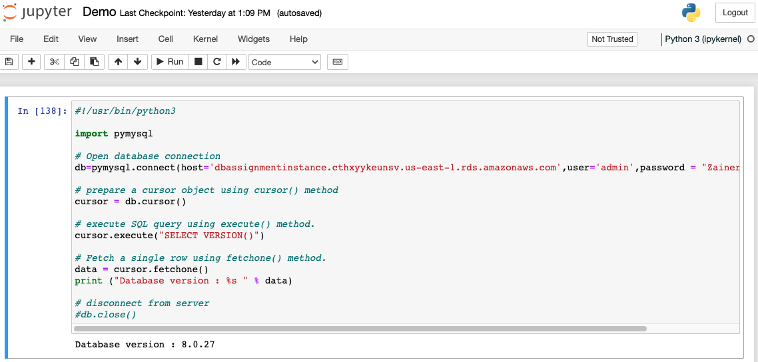
QuickSight | Setting up Jupyter notebook
1- ssh -L localhost:8888:localhost:8888 -i "VPC-MOJAHID-PRI.pem" ubuntu@ec2-100-26-215-145.compute-1.amazonaws.com
2- Open the demo notebook
3- Load data and create new table in the DB

Slide 15
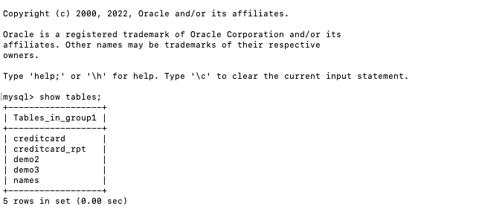
QuickSight | Setting up data in MySql
mysql -h dbassignmentinstance.cthxyykeunsv.us-east-1.rds.amazonaws.com -u admin -pZainer123 group1

Slide 16
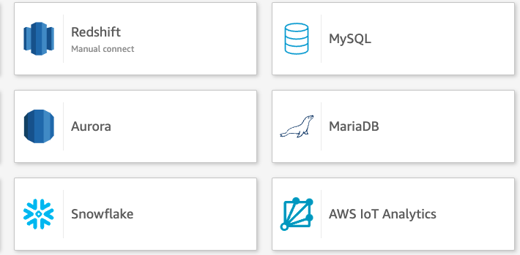
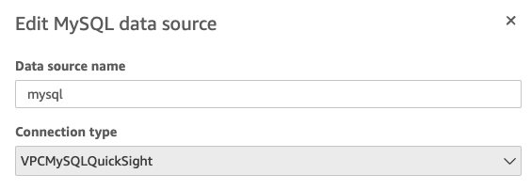
QuickSight | Starting and configuring
1
1- Go to Quicksight https://us-east-1.quicksight.aws.amazon.com/sn/start
2- Create new Dataset (connect to our DB )
2
3

Slide 17
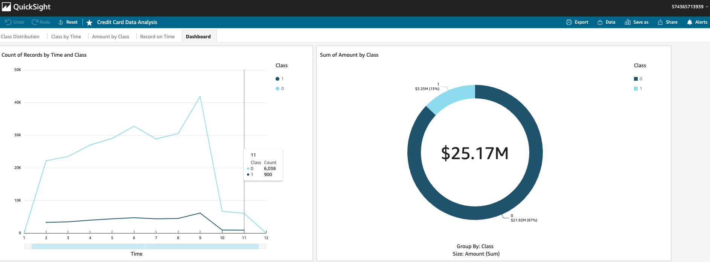
QuickSight | Perform BI on data

Slide 18
Agenda
Introduction, dataset and project approach
AWS architecture
Setting up QuickSight
EDA
Machine Learning and modeling
Final representation
Conclusion

Slide 19
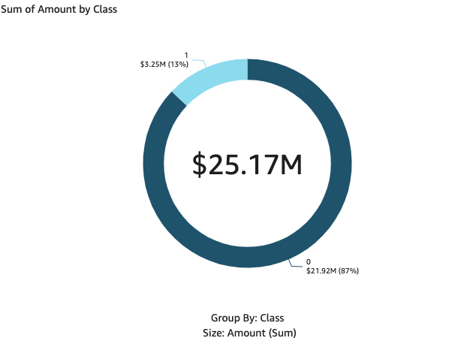
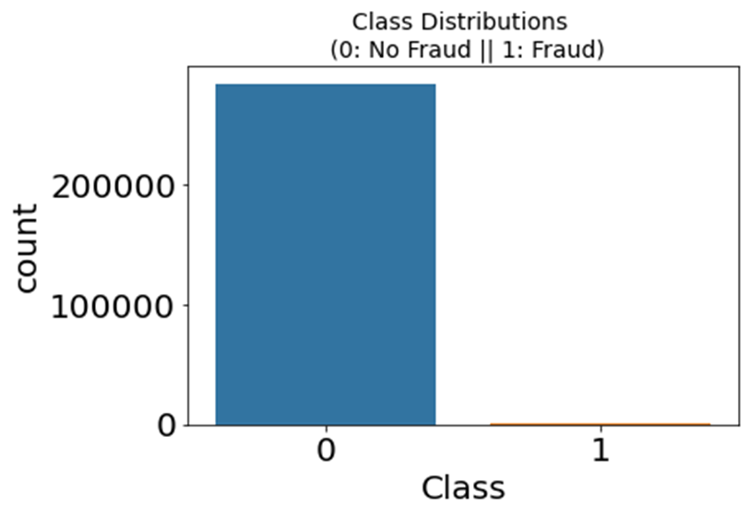
EDA | Initial analysis
QuickSight
Python Libraries

Slide 20
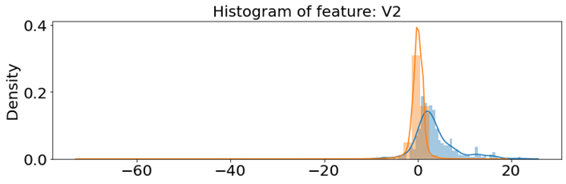
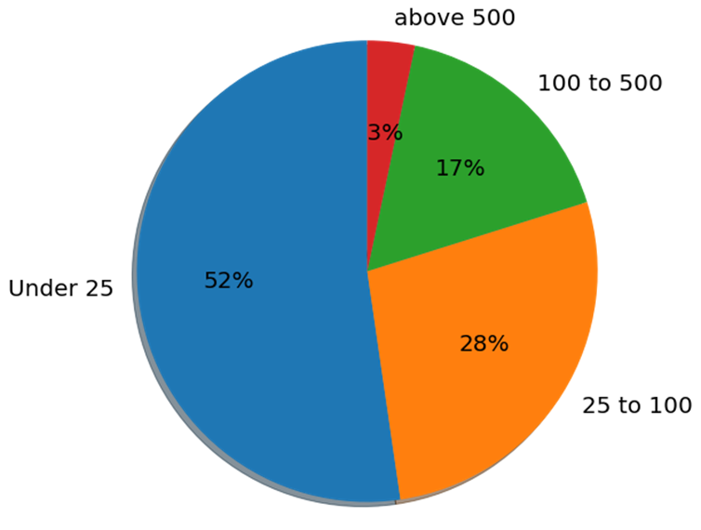
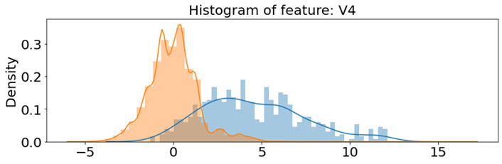
EDA Key Takeaways
Highly imbalanced data that will need oversampling or under sampling
Only data that we can read is the transaction time and amount
All other data features are PCA transformed which cannot provide any context
Notes:
- Mojahid Takes over

Slide 21
Data processing steps
Split the data into Train and Test data
Split Train into Train and Validation
Remove outliers
Convert time to a categorical field
Scaling the data
Oversampling and under-sampling
Notes:
- Mina takes over

Slide 22
Agenda
Introduction, dataset and project approach
AWS architecture
Setting up QuickSight
EDA
Machine Learning and modeling
Final representation
Conclusion

Slide 23
Pipeline approach:
Start
Load and explore the data
Undersampling
Handling class imbalance
Oversampling
Scale, remove outlier and undersample
Use SMOTE
Use ADASYN
LogisticRegression
MLPClassifier
DecisionTreeClassifier
LogisticRegression
FNN using two sets of training data (SMOTE and ADASYN)

Slide 24
Pipeline approach (Sagemaker auto-pilot):
Start
Load and explore the data
Undersampling
Handling class imbalance
Oversampling
Scale, remove outlier and undersample
Use SMOTE
Use ADASYN
LogisticRegression
MLPClassifier
DecisionTreeClassifier
LogisticRegression
FNN using two sets of training data (SMOTE and ADASYN)

Slide 25
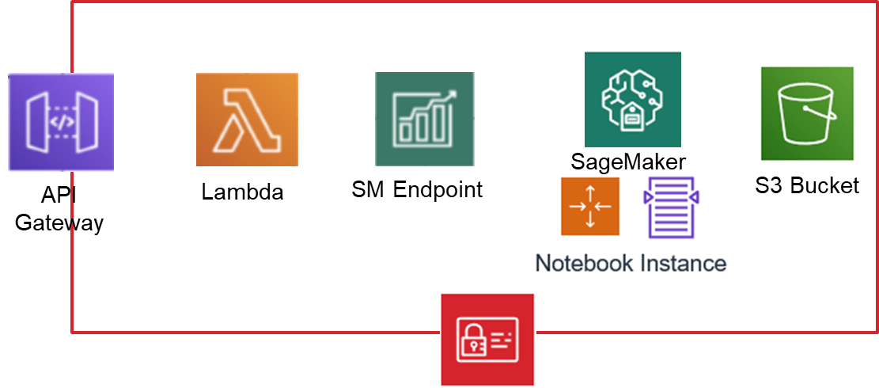
SageMaker Pipeline

Slide 26
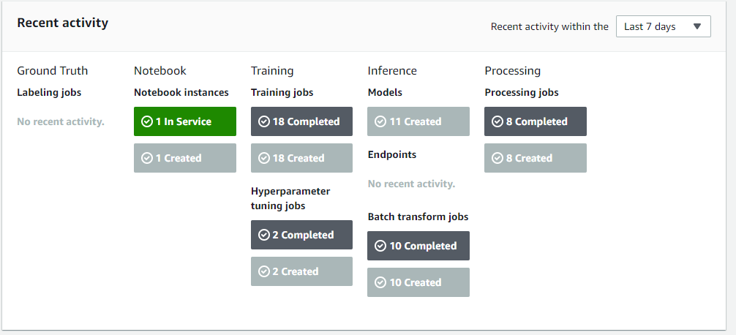
SageMaker Pipeline
8 Sklearn job (MLP)
5 Linear learner
5 Gradient boost
Data Splitter
Pipeline recommender
Data Splitter
Pipeline recommender
sagemaker-clarify-processing
sagemaker-clarify-processing
sagemaker-model-monitor-analyzer
sagemaker-model-monitor-analyzer
JobStatus Secondary Status
InProgress - AnalyzingData | 12 mins
InProgress - FeatureEngineering | 10 mins
InProgress - ModelTuning | 11 mins
InProgress - GeneratingExplainabilityReport | 9 mins
InProgress - GeneratingModelInsightsReport | 13 mins

Slide 27
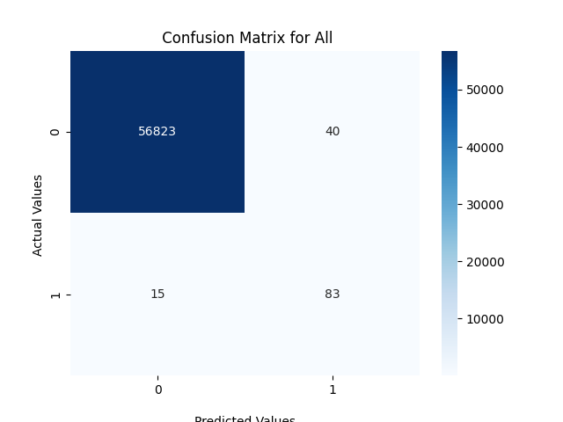
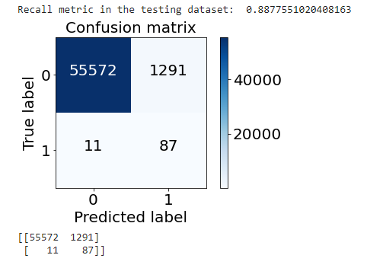
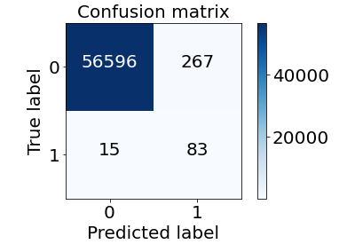
Comparison

Slide 28
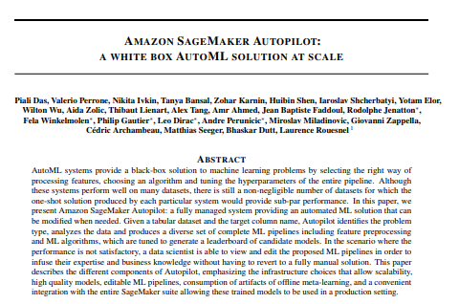
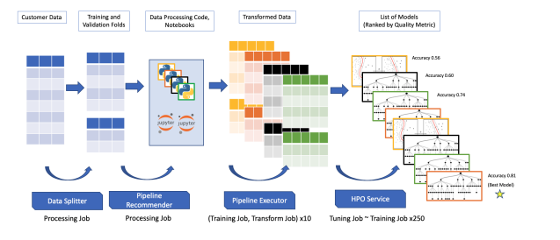
The auto-pilot flow
https://arxiv.org/pdf/2012.08483.pdf

Slide 29
Agenda
Introduction, dataset and project approach
AWS architecture
Setting up QuickSight
EDA
Machine Learning and modeling
Final representation
Conclusion

Slide 30
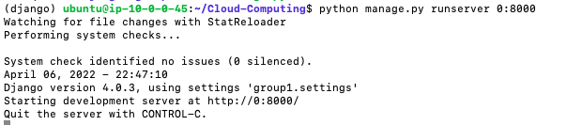
Django | Starting and configuring
1- ssh -i "VPC-MOJAHID-PRI.pem" ubuntu@ec2-100-26-215-145.compute-1.amazonaws.com
2- source venv/bin/activate
3- python manage.py runserver 0:8000

Slide 31
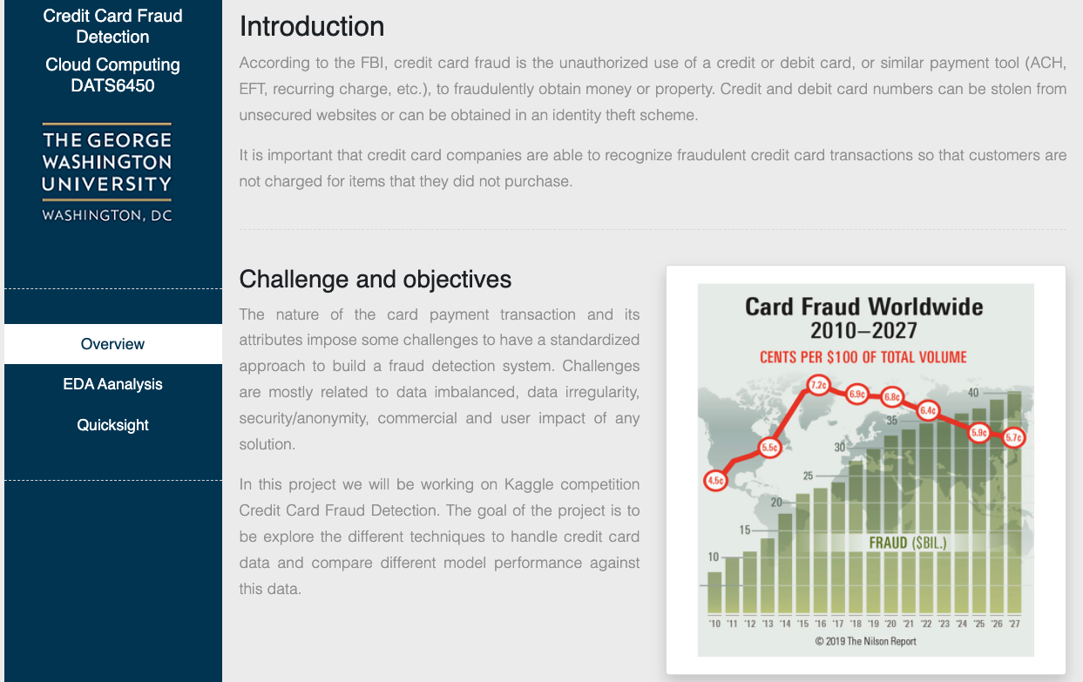
Django | Final page

Slide 32
Agenda
Introduction, dataset and project approach
AWS architecture
Setting up QuickSight
EDA
Machine Learning and modeling
Final representation
Conclusion

Slide 33
Agenda
Introduction, dataset and project approach
AWS architecture
Setting up QuickSight
EDA
Machine Learning and modeling
Final representation
Conclusion

Slide 34
Conclusion
AWS offers a very long list of great application with very intuitive interface but the question is when to use AWS vs other options
Based on our experience, we concluded that:
Common business problems can be easily utilized via AWS services (i.e. Sagemaker auto-pilot) to leverage AWS fast pipeline setup and good performing models
Critical systems, untapped problems or research problems might require more hands-on to ensure that proper parameters are selected
Resources has to be analyzed in depth to evaluate right decisions

Slide 35

Questions ?

Slide 37
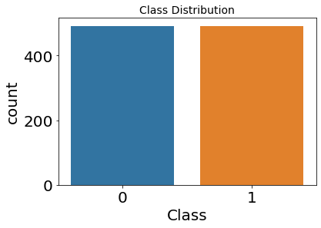
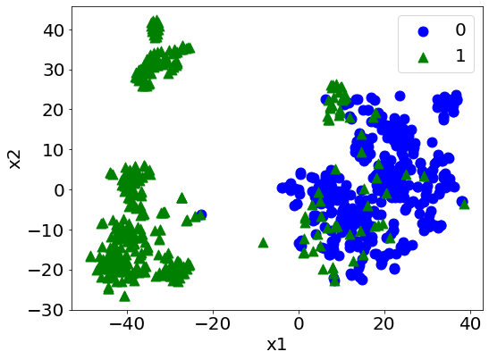
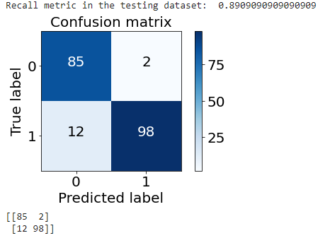
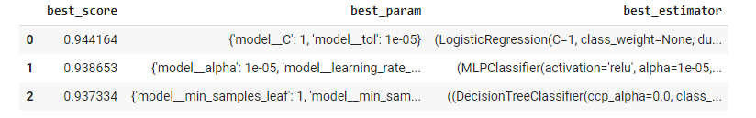

Undersampling
Distribution of the Classes in the undersampled dataset
Applying our shallow models

Slide 38
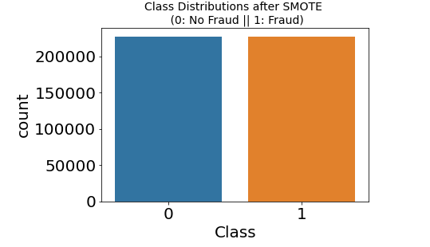
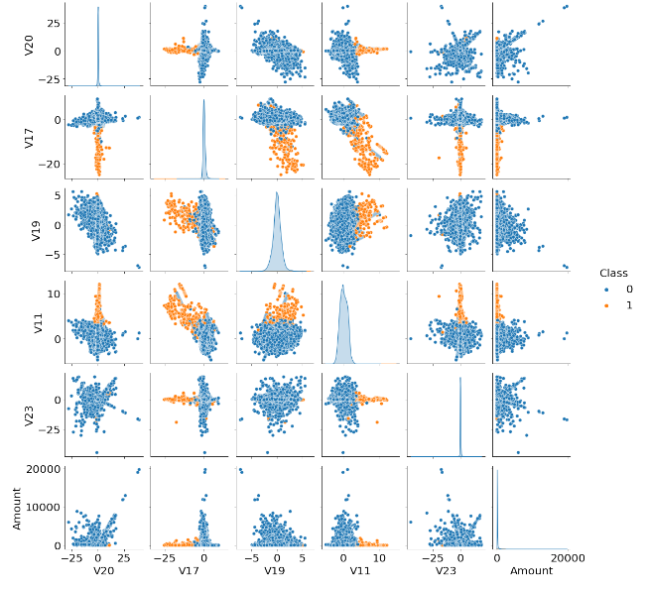
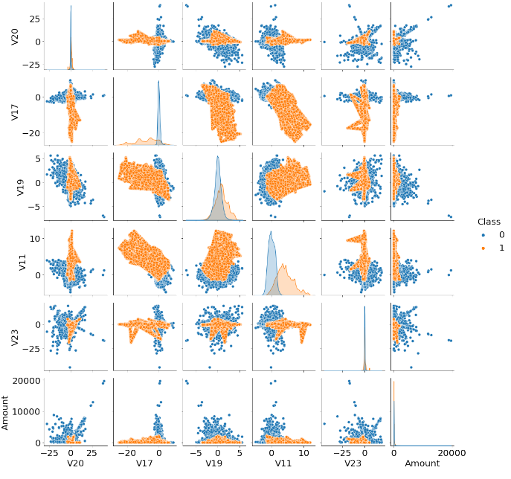
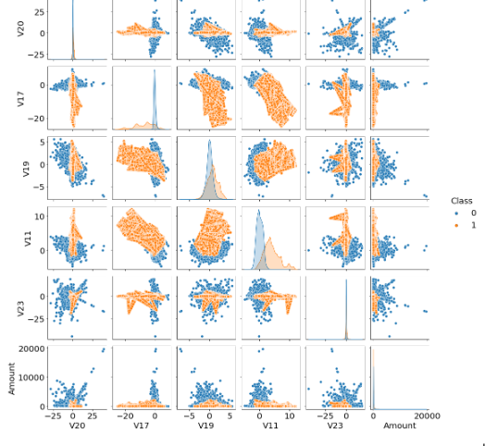
Oversampling - SMOTE
Distribution of the Classes in the oversampled dataset

Slide 39
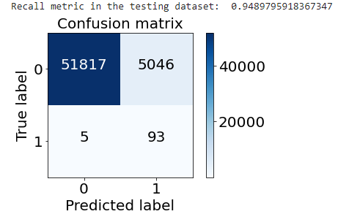
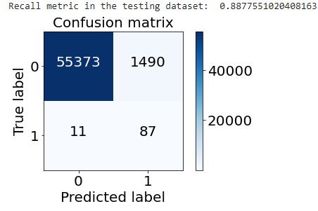
Logistic Regression comparison
SMOTE
ADASYN
Undersample dataset
Oversampled dataset

Slide 40
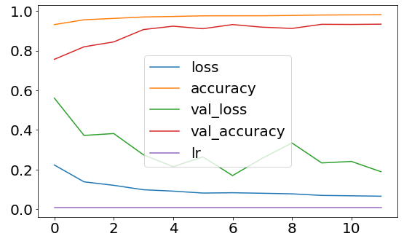
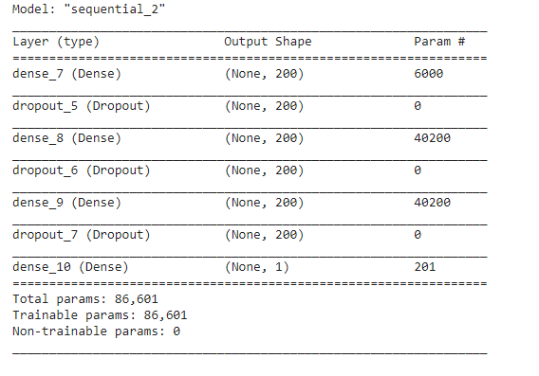
Neural network models SMOTE

Slide 41
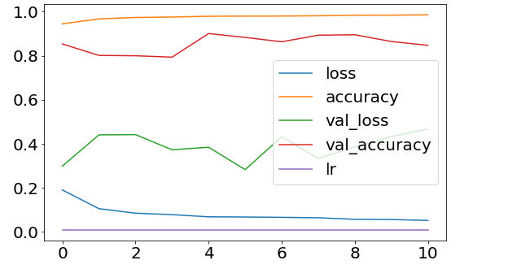
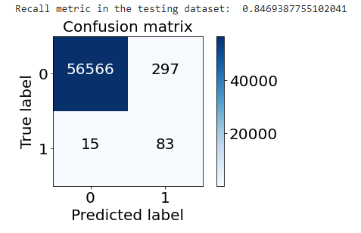
Neural network models ADASYN

Slide 42
Conclusion
Focusing on the minority class:
Undersampling resulted in significantly high recall with low precision
Models using oversampled data resulted in significantly high precision but lower recall when compared to models using undersampled data
SMOTE or ADASYN resulted to a very similar model performance
DNN Using oversampled dataset resulted in the best balance between recall and precision
Minority class best model performance
 | Undersampling | Undersampling after outlier removal | Oversampling - LR | Oversampling - DNN
Precision | 3.92% | 1.8% | 6.3% | 23.7%
Recall | 90.8% | 94.9% | 88.8% | 84.6%

Slide 43
Model selection criteria
How payment networks evaluate fraud prevention models (rough estimate):
Value of fraud prevention gains due to true negative (FG)
Value of lost interchange revenue due to false positive (IL)
Loss interchange revenue should exceed gains from fraud prevention
FG = AVG(Transaction Amount) (TN - FN)
IL = FP * AVG(Transaction Amount) * Interchange
Assumptions:
AVG Transaction Amount in the test dataset is 78.5 Euros
Interchange is 2% from the Transaction Amount
Using the test dataset
 | Recall | FG | IL | Net Gain
Undersample w/o outliers | 94.9% | 6908 | 7922 | - 1014
Undersample LR | 90.8% | 6280 | 3422 | + 2857
Oversample LR | 88.8% | 5966 | 2026 | + 3939
Oversample DNN | 84.6% | 5338 | 419 | + 4918

Slide 44
The data challenge
The nature of the card payment transaction and its attributes impose some challenges to have a standardized approach to build a fraud detection system. Some of these challenges are explained in the following list:
Data irregularity: As highlighted in the previous section, credit card transactions data are highly imbalanced because only a very few fraction of the transactions are fraudulent
Secure nature of the data: The credit card data and other attributes has to follow different security regulations with regards to confidentiality and privacy which restrict the sharing of the data between multiple institutions.
Precision and recall impact: The criteria of model selection has to consider the high impact of false negative compared to false positive classification
Commercial aspects and user experience: Since the majority of credit card transaction are not of a very high dollar value, the cost of prevention and the impact to the user experience in terms of speed has to considered when processing the data and defining the best model

